Slide 1
Finding the critical factors that drive mortality rates in major Canadian cities
Mortality rates, health care access, behaviours and socioeconomic factors
By: Avis Sokol, Irina Drapic, Suman Raj, Haneul Kim

Slide 2
Hypotheses, Data Gathering and Analytical Approach
Key Questions
Data Sources and Challenges
Assessment
Which city has the lowest mortality rate?
What are some of the key factors that drive these improved outcomes?
lifestyle?
health care access?
socioeconomic?
Stats Canada, Canadian Medical Association, McGill University – list of Canadian hospitals
Cleaning included reviewing and putting cities into the correct CMAs
Challenges:
finding data, limited versus US, or at a cost
defining the same geographic areas across datasets
Initially used google API to identify hospitals but the API included more than hospitals
A total of 15 variables were assessed including:
lifestyle – smokers, drinking, obesity, BMI, perceived health
health care access – number of physicians in the community, number of hospitals
Socioeconomic – average income, poverty rates

Slide 3
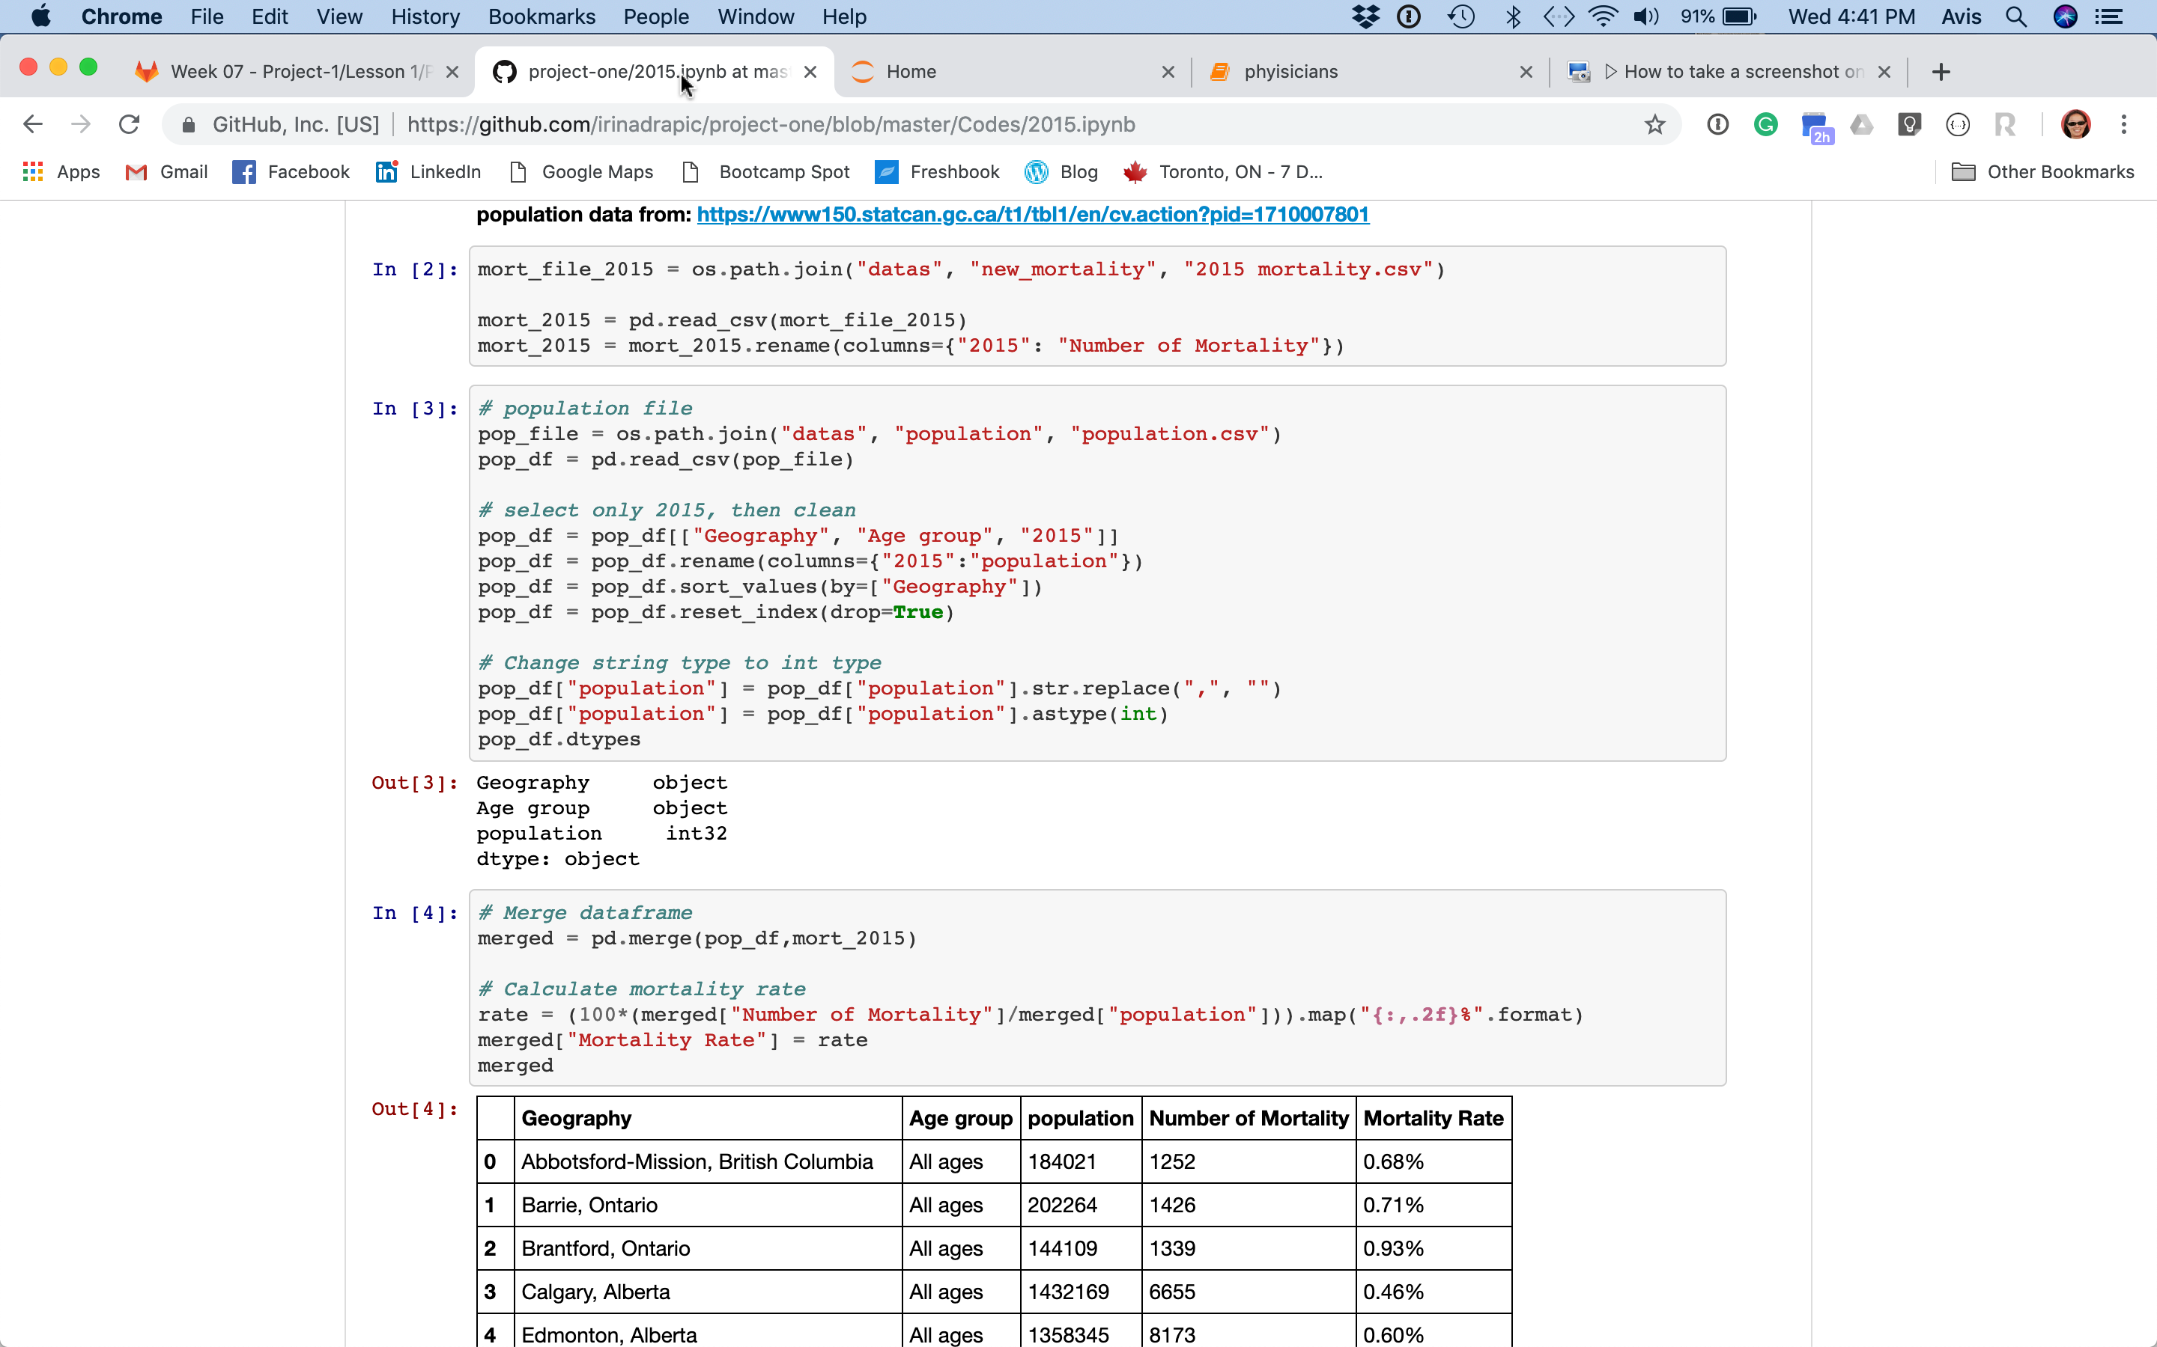
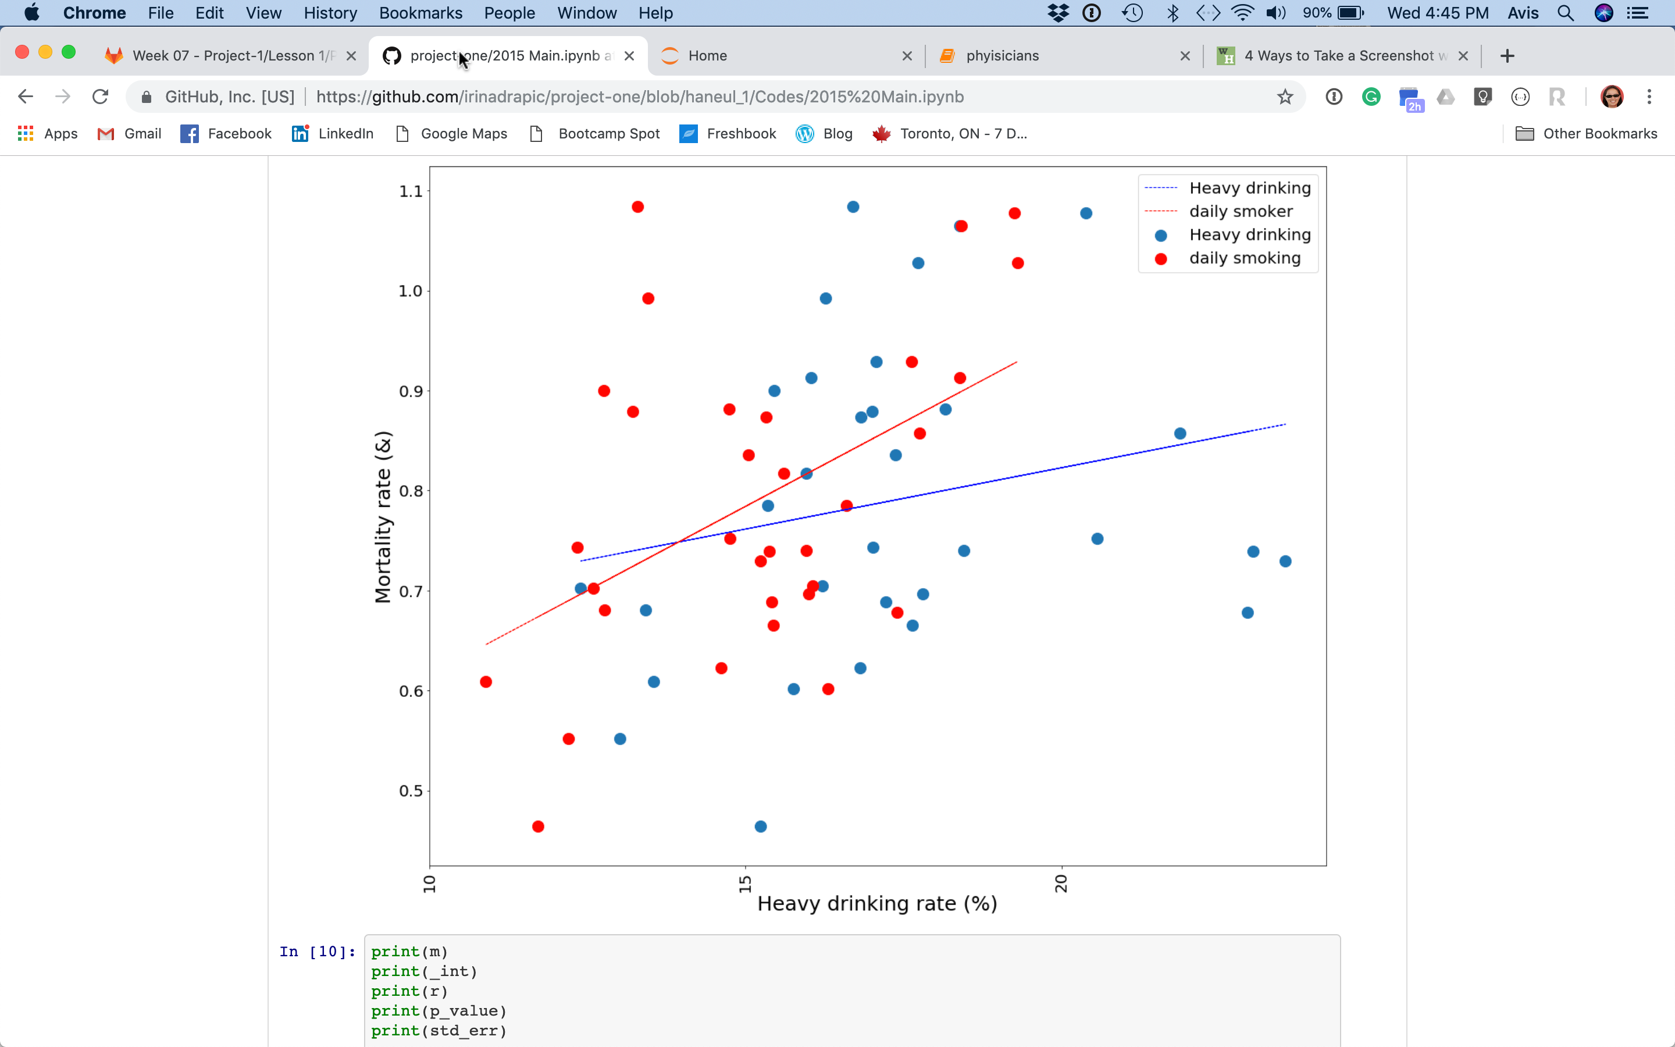
Cleaning and Processing

Slide 4
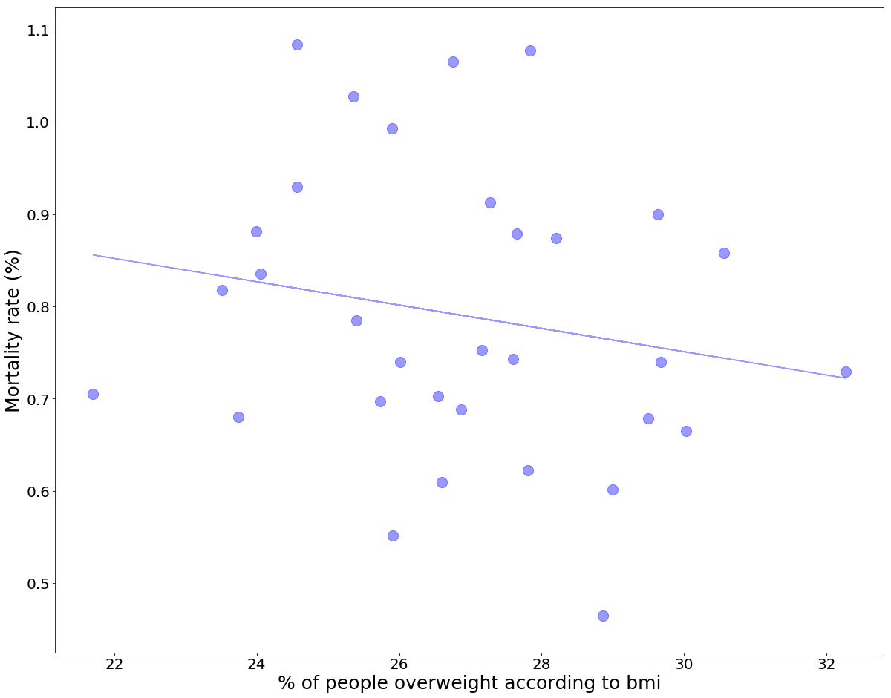
What impact does lifestyle and perceived health have on mortality?
P-value = 0.0178
Y = 0.04x + 0.4
P-value > significance interval. Null is rejected and there is positive relationship, it is not due to chance.
P-value were less than significance interval (alpha) so it cannot reject the null hypothesis which is “there is no significance affect of independent variable on dependent(mortality rate)
P-value = 0.066
Y = -0.019x + 1.4
P-value = .125
P-value = 0.94
Y = 0.001x + 0.78

Slide 5
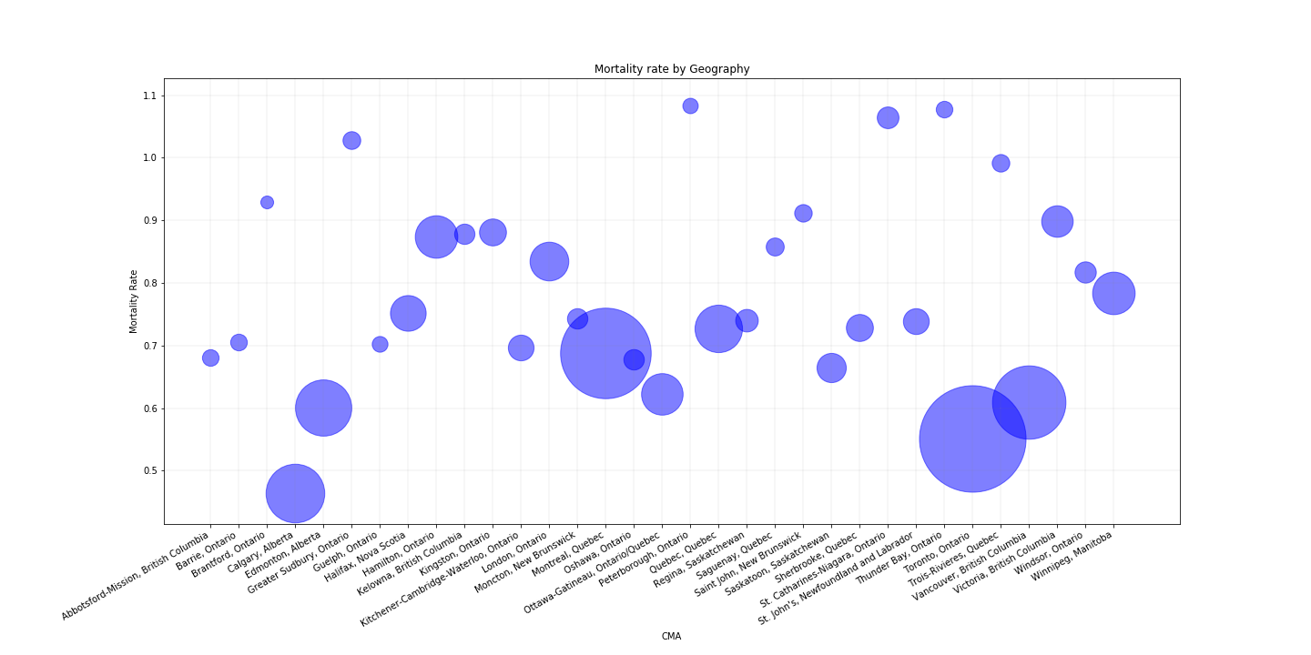

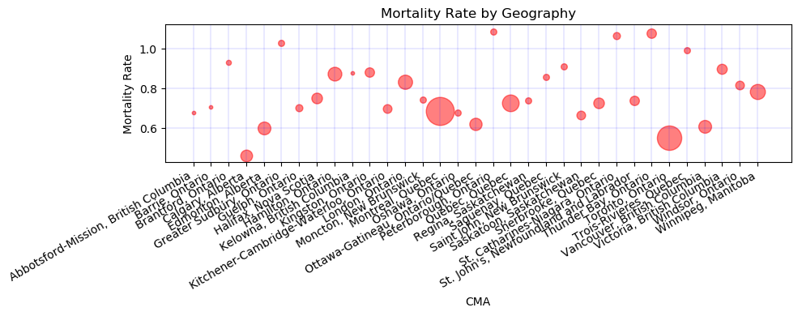
Mortality Rates by CMA with health services access
Canada’s 6 largest census metropolitan areas enjoy the lowest mortality rates, these centres also have the highest concentration of doctors(as indicated by the size of the circle), specialists who are required to treat major health issues

Slide 6
Impact of income on mortality rates
Communities with higher income do not enjoy higher mortality rates.

Slide 7
Conclusions
Mortality rates are best in Toronto, Calgary, Edmonton, Vancouver and Ottawa/Gatineau
Our initial perceptions on what would drive improved mortality rates did not hold true
Issues are more complex than they seem
Living in major centres with access to more medical specialists has an impact as well as ones own perception of health, state of mental health and stress

